Slide 1
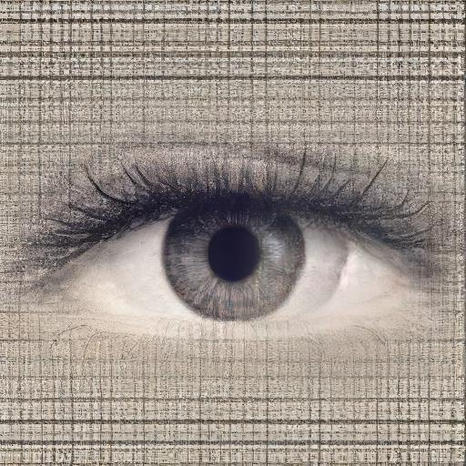
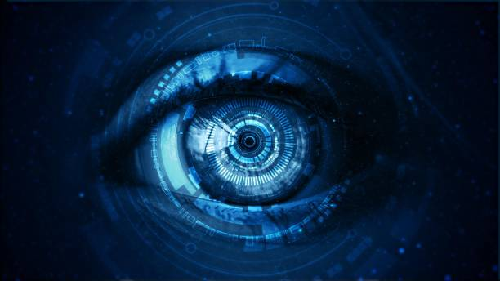
CURSOR CONTROL U S I N G E Y E M O V E M E N T S
Name : Sahil Katkamwar
Roll No : 33331
Guide : Ms. Jyoti H. Jadhav
Reviewer : Dr. Shyam B. Deshmukh

Slide 2

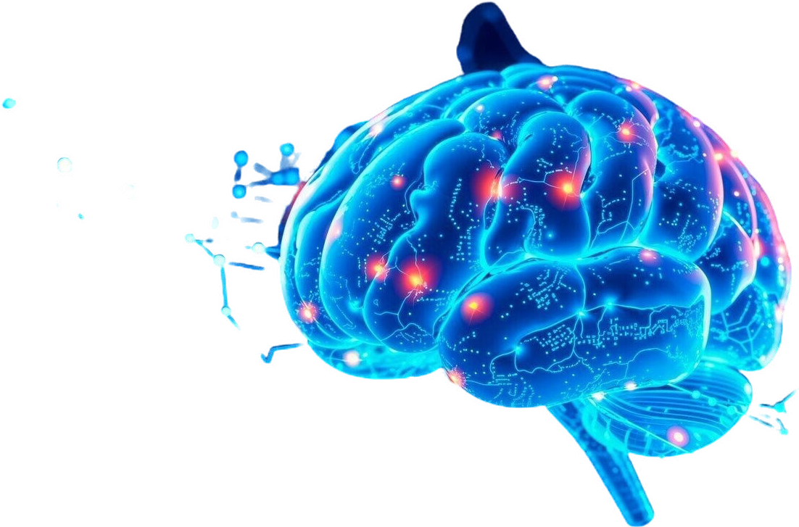
Introduction
What is the Virtual Mouse?
An innovative system that uses eye movements to control a computer’s mouse without physically touching a device.
Objective of the System:
To create a hands-free, contactless interface that replaces traditional mouse functions with simple eye movements, enhancing accessibility and user experience.

Slide 3
Literature Survey
Research Paper | Technology Used | Algorithm Used | Result Finding
Human-computer interaction Based on the Eye-tracking - Jingjing Zhou, Yi Zhu (2024) | Eye posture and gaze tracking, HCI | Blink Detection Algorithm | The system successfully distinguishes between conscious and involuntary blinks, enabling accurate eye-controlled commands. Test results show consistent performance across basic actions like left-click, right-click, drag, and scroll, with high accuracy in 30 trials per action.
EYE-CONTROLLED MOUSE CURSOR - M. S., S. Nirmal, and L. S. Kala (2023) | OpenCV, PyAutoGUI | SVM | The system using SVM is simple, cost-effective, and widely accessible but has lower gesture detection accuracy and movements that are not as smooth.
Mouse Cursor Movement and Control Using Eye Gaze - P. Miah, M. R. Gulshan, and N. Jahan (2023) | CNN, MediaPipe | Mouse Cursor Movement and Control using Eye Gaze | The system's accuracy ranges between 80-85%, with optimal performance in bright sunlight. At night, accuracy drops to around 75%, but good illumination ensures decent results.

Slide 4
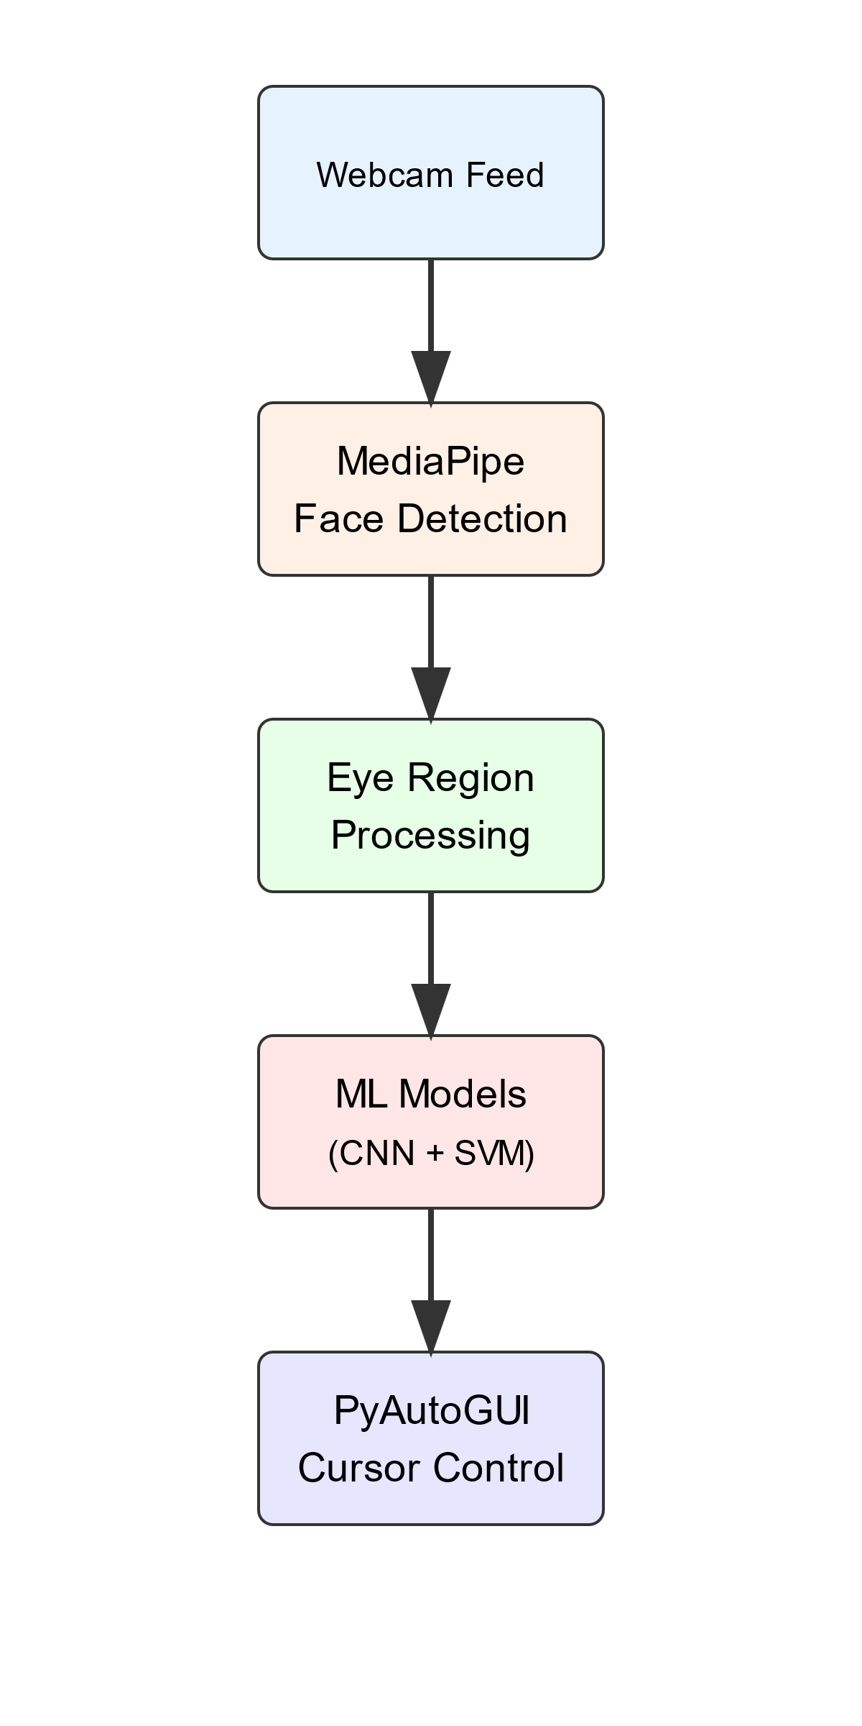
Framework/Basic Architecture
Below is an Overview of the main stages in System’s Architecture:-
Input Stage: Captures live video through a webcam using OpenCV and MediaPipe
Processing Stage: Detects gaze direction and tracks movements using algorithms. Blinkings are mapped to mouse functions like clicks
Output Stage: Uses PyAutoGUI to control cursor actions on the screen based on the interpreted movements.

Slide 5
Algorithms
Algorithm | Time Complexity | Application | Limitation
Support Vector Machine (SVM) | O(n^2) to O(n^3) (depending on the kernel) | Classifying eye movements and blink patterns. | Sensitive to noise and outliers
Convolutional Neural Network (CNN) | O(n * k^2) (where k is the kernel size) | Eye region feature extraction. | Requires large datasets and computational resources
MediaPipe | Varies by model, generally O(n) | Facial landmark detection and tracking. | Computationally expensive at prediction time

Slide 6
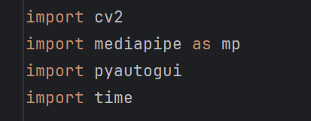

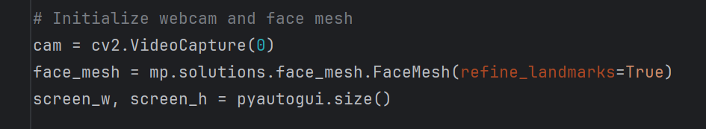
Implementation
1. Tools and Libraries Used:-
Python: Primary programming language for the project.
OpenCV: For capturing video from the webcam and processing image frames.
Mediapipe: For real-time gaze tracking and eye movement recognition.
2. Steps Involved:-
Video Capture: Webcam captures real-time video.
Eye Movement Detection: Mediapipe’s eye-tracking model identifies hand landmarks.

Slide 7
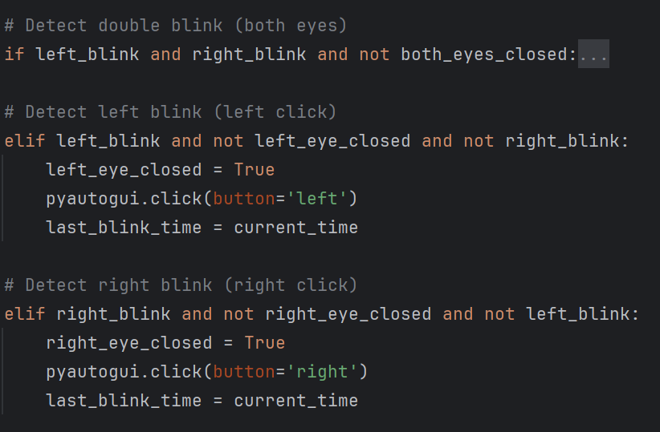
Gesture Recognition: Analyzing blinking to recognize movements (like moving the cursor or clicking).
Mouse Control: Using Autopy, gestures are converted into mouse movements and clicks.

Slide 8
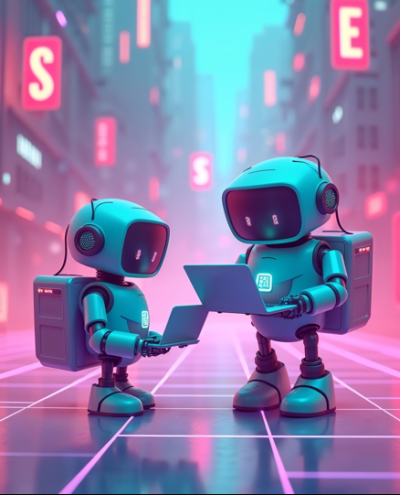
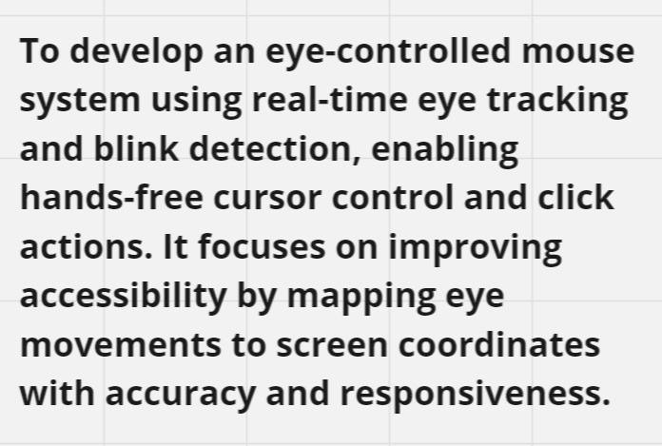
Probable Problem Statement for BE

Slide 9
Applications
Gaming :-
Allows for gesture-based controls in gaming, creating a more immersive experience
2. Virtual and Augmented Reality (VR/AR):-
Facilitates navigation and interaction in 3D environments
3. Assistive Technology for Disabled Users:-
Allows users to control a computer by directing the cursor with their gaze

Slide 10
Conclusion
In the field of Human-Computer Interaction (HCI), this research explores a machine learning-based approach for cursor control using eye movements, offering an intuitive and hands-free method of interaction. By leveraging algorithms like CNNs and SVMs, the system aims to improve gaze detection and translate it into precise cursor actions, minimizing errors. The research further examines a geometric model for optimal camera placement and introduces a calibration phase for user customization. This work highlights the potential for future advancements in accessible and touchless user interfaces, especially for individuals with physical limitations.

Slide 11
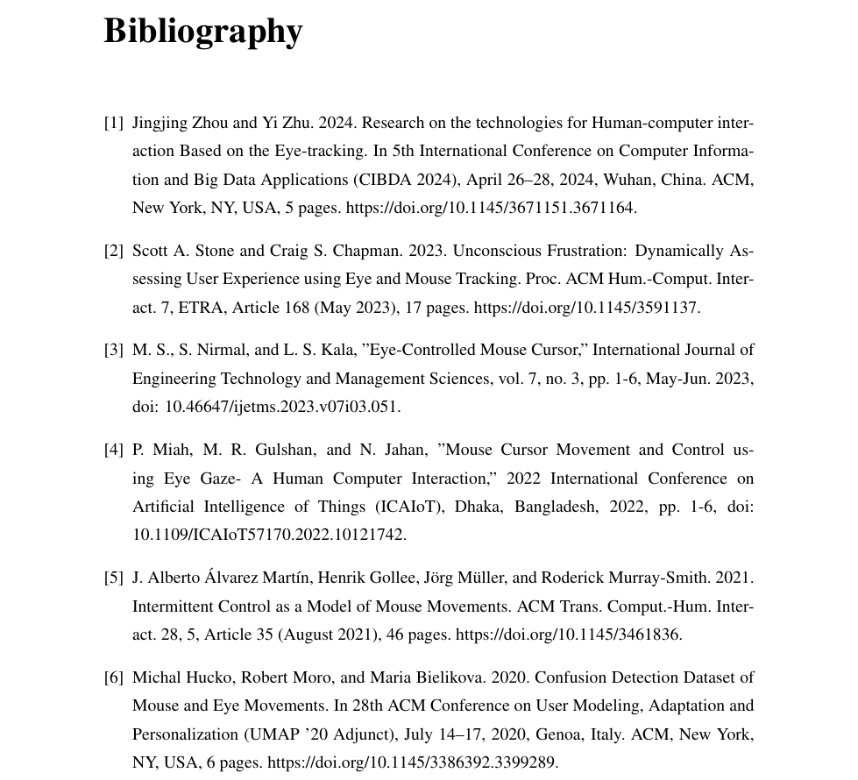

Slide 12
___Thank___
___You___

